Slide 1
Chapter 8
Approximation Algorithms

Slide 2
Outline
Why approximation algorithms?
The vertex cover problem
The set cover problem
TSP

Slide 3
Why Approximation Algorithms ?
Many problems of practical significance are NP-complete but are too important to abandon merely because obtaining an optimal solution is intractable.
If a problem is NP-complete, we are unlikely to find a polynomial time algorithm for solving it exactly, but it may still be possible to find near-optimal solution in polynomial time.
In practice, near-optimality is often good enough.
An algorithm that returns near-optimal solutions is called an approximation algorithm.

Slide 4
Performance bounds for approximation algorithms
i is an optimization problem instance
c(i) be the cost of solution produced by approximate algorithm and c*(i) be the cost of optimal solution.
For minimization problem, we want c(i)/c*(i) to be as small as possible.
For maximization problem, we want c*(i)/c(i) to be as small as possible.
An approximation algorithm for the given problem instance i, has a ratio bound of p(n) if for any input of size n, the cost c of the solution produced by the approximation algorithm is within a factor of p(n) of the cost c* of an optimal solution. That is
max(c(i)/c*(i), c*(i)/c(i)) ≤ p(n)

Slide 5
Note that p(n) is always greater than or equal to 1.
If p(n) = 1 then the approximate algorithm is an optimal algorithm.
The larger p(n), the worst algorithm
Relative error
  We define the relative error of the approximate algorithm for any input size as
  |c(i) - c*(i)|/ c*(i)
  We say that an approximate algorithm has a relative error bound of ε(n) if
  |c(i)-c*(i)|/c*(i)≤ ε(n)

Slide 6
1. The Vertex-Cover Problem
Vertex cover: given an undirected graph G=(V,E), then a subset V'⊆V such that if (u,v)∈E, then u∈V' or v ∈V' (or both).
Size of a vertex cover: the number of vertices in it.
Vertex-cover problem: find a vertex-cover of minimal size.
This problem is NP-hard, since the related decision problem is NP-complete

Slide 7
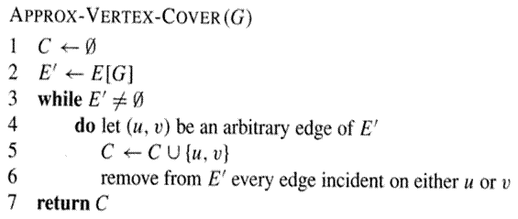
Approximate vertex-cover algorithm
The running time of this algorithm is O(E).

Slide 8
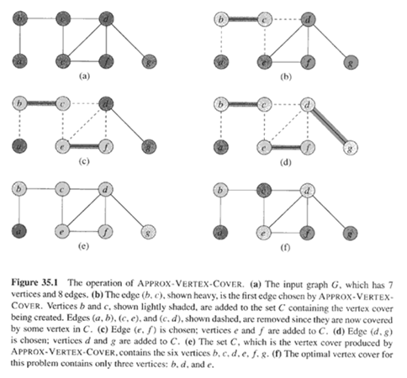

Slide 9
Theorem:
APPROXIMATE-VERTEX-COVER has a ratio bound of 2, i.e., the size of returned vertex cover set is at most twice of the size of optimal vertex-cover.
Proof:
  It runs in poly time
  The returned C is a vertex-cover.
  Let A be the set of edges picked in line 4 and C* be the optimal vertex-cover.
    Then C* must include at least one end of each edge in A and no two edges in A are covered by the same vertex in C*, so |C*|≥|A|.
    Moreover, |C|=2|A|, so |C|≤2|C*|.

Slide 10
The Set Covering Problem
The set covering problem is an optimization problem that models many resource-selection problems.
An instance (X, F) of the set-covering problem consists of a finite set X and a family F of subsets of X, such that every element of X belongs to at least one subset in F:
X = ∪ S
S∈F
We say that a subset S∈F covers its elements.
The problem is to find a minimum-size subset C ⊆ F whose members cover all of X:
X = ∪ S
S∈C
We say that any C satisfying the above equation covers X.

Slide 11
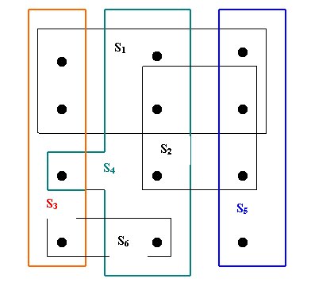
Figure 6.2 An instance {X, F} of the set covering problem, where X consists of the 12 black points and F = { S₁, S₂, S₃, S₄, S₅, S₆}. A minimum size set cover is C = { S₃, S₄, S₅}. The greedy algorithm produces the set C’ = {S₁, S₄, S₅, S₃} in order.

Slide 12
Applications of Set-covering problem
Assume that X is a set of skills that are needed to solve a problem and we have a set of people available to work on it. We wish to form a team, containing as few people as possible, s.t. for every requisite skill in X, there is a member in the team having that skill.
Assign emergency stations (fire stations) in a city.
Allocate sale branch offices for a company.
Schedule for bus drivers.

Slide 13
A greedy approximation algorithm
Greedy-Set-Cover(X, F)
1. U = X
2. C = ∅
3. while U != ∅ do
4. select an S∈F that maximizes | S ∩ U|
5. U = U – S
6. C = C ∪ {S}
7. return C
The algorithm GREEDY-SET-COVER can easily be implemented to run in time complexity in |X| and |F|. Since the number of iterations of the loop on line 3-6 is at most min(|X|, |F|) and the loop body can be implemented to run in time O(|X|,|F|), there is an implementation that runs in time O(|X|,|F| min(|X|,|F|) .

Slide 14
Ratio bound of Greedy-set-cover
Let denote the dth harmonic number
d
h_{d} = Σ_{i-1}1/i
Theorem: Greedy-set-cover has a ratio bound H(max{|S|: S ∈F})
Corollary: Greedy-set-cover has a ratio bound of (ln|X| +1)
(Refer to the text book for the proofs)

Slide 15
3. The Traveling Salesman Problem
Since finding the shortest tour for TSP requires so much computation, we may consider to find a tour that is almost as short as the shortest. That is, it may be possible to find near-optimal solution.
Example: We can use an approximation algorithm for the HCP. It's relatively easy to find a tour that is longer by at most a factor of two than the optimal tour. The method is based on
  the algorithm for finding the minimum spanning tree and
  an observation that it is always cheapest to go directly from a vertex u to a vertex w; going by way of any intermediate stop v can’t be less expensive.
  C(u,w) ≤ C(u,v)+ C(v,w)

Slide 16
APPROX-TSP-TOUR
The algorithm computes a near-optimal tour of an undirected graph G.
procedure APPROX-TSP-TOUR(G, c);
begin
select a vertex r ∈ V[G] to be the “root” vertex;
grow a minimum spanning tree T for G from root r, using Prim’s algorithm;
apply a preorder tree walk of T and let L be the list of vertices visited in the walk;
form the halmintonian cycle H that visits the vertices in the order of L.
/* H is the result to return * /
end
A preorder tree walk recursively visits every vertex in the tree, listing a vertex when its first encountered, before any of its children are visited.

Slide 17
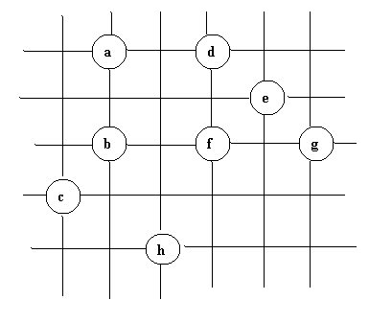
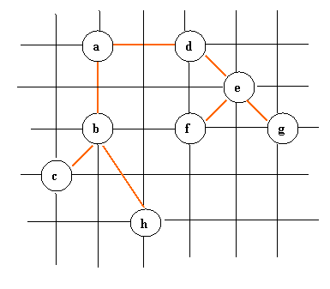
Thí dụ minh họa giải thuật APPROX-TSP-TOUR

Slide 18

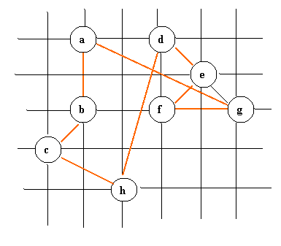
The preorder tree walk is not simple tour, since a node be visited many times, but it can be fixed, the tree walk visits the vertices in the order a, b, c, b, h, b, a, d, e, f, e, g, e, d, a. From this order, we can arrive to the hamiltonian cycle H: a, b, c, h, d, e ,f, g, a.

Slide 19
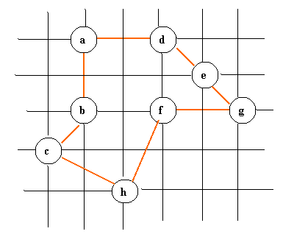
The optimal tour
The total cost of H is approximately 19.074. An optimal tour H* has the total cost of approximately 14.715.
The running time of APPROX-TSP-TOUR is O(E) = O(V²), since the input graph is a complete graph.

Slide 20
Ratio bound of APPROX-TSP-TOUR
Theorem: APPROX-TSP-TOUR is an approxima-tion algorithm with a ratio bound of 2 for the TSP with triangle inequality.
Proof: Let H* be an optimal tour for a given set of vertices. Since we obtain a spanning tree by deleting any edge from a tour, if T is a minimum spanning tree for the given set of vertices, then
c(T) ≤ c(H*) (1)
A full walk of T traverses every edge of T twice, we have:
c(W) = 2c(T) (2)
(1) and (2) imply that:
c(W) ≤ 2c(H*) (3)

Slide 21
But W is not a tour, since it visits some vertices more than once. By the triangle inequality, we can delete a visit to any vertex from W. By repeatedly applying this operation, we can remove from W all but the first visit to each vertex.
Let H be the cycle corresponding to this preorder walk. It is a hamiltonian cycle, since every vertex is visited exactly once. Since H is obtained by deleting vertices from W, we have
c(H) ≤ c(W) (4)
From (3) and (4), we conclude:
c(H) ≤ 2c(H*)
So, APPROX-TSP-TOUR returns a tour whose cost is not more than twice the cost of an optimal tour.

Slide 22
Appendix: A Taxonomy of Algorithm Design Strategies
Strategy name Examples
----------------------------------------------------------------------------------------
Bruce-force Sequential search, selection sort
Divide-and-conquer Quicksort, mergesort, binary search
Decrease-and-conquer Insertion sort, DFS, BFS
Transform-and-conquer heapsort, Gauss elimination
Greedy Prim’s, Dijkstra’s
Dynamic Programming Floyd’s
Backtracking
Branch-and-Bound
Approximate algorithms
Heuristics
Meta-heuristics

